Slide 1

CAPSTONE PROJECT - THE BATTLE OF NEIGHBORHOODS (Capstone Project)
DALCIDE Shelsy

Slide 2
Problem
A parent is working in the South side of a town while his kid’s school is in the North, his job ends at 5 but at 3 he has to go take his kid at school then to take her to her dance class.
This problem concerns one parent who wants to know what is the Elementary School in Chicago with a dance very close where he can register his kid. But he doesn’t want any kind of school, the one he wants must have a good safety score, the education level must be high and so do the teachers score.
How to find a school dance next to an Elementary school in Chicago with a high score of Instruction and where the teachers score and the safety score is also high.

Slide 3
Methodology
In order to resolve our business problem we need the data about elementary public school In Chicago. We found our dataset on Kaggle, this dataset is hosted by the city of Chicago.
After having done our data processing import our libraries look at the types of each column on jupyter notebook calculate their average describes our numeric columns. our dataset was at about 78 columns after our analysis it was reduced to those columns which are necessary for us:
NAME_OF_SCHOOL,Elementary,Middle, or High School,SAFETY_SCORE,Instruction Score,Teachers Score,Latitude,Longitude,COMMUNITY_AREA_NAME,Location,Street Address
We requested data on dance schools located in chicago thanks to foursquare in order to achieve our goal of finding a primary school with a high level of education, high scoring teachers and a high safety score next to a school dance.
We have created maps to see the city of Chicago and the addresses of the Schools.

Slide 4
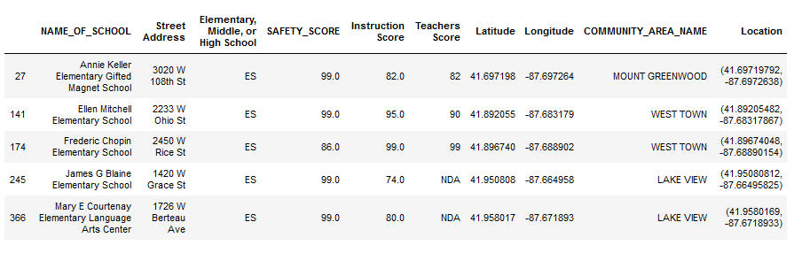
Results
Here we have all School Elementary, Middle, or High School with a high score
There is nine School Elementary with high score in Chicago

Slide 5
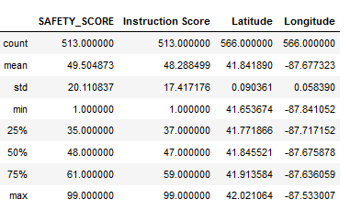
Results
We describe our dataset pf School Elementary
We can see how many on average these School are safe for the children the instruction Score The Latitude and the Longitude. The minimum and maximum value of each columns

Slide 6
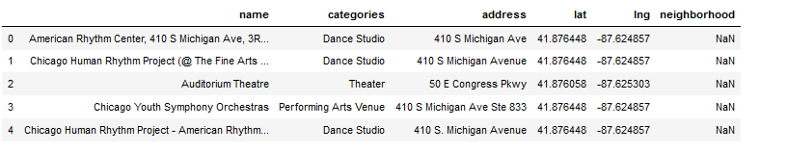
Results
Here we used foursquare to find data on dance schools in chicago and we filtered his data to get our necessary columns

Slide 7
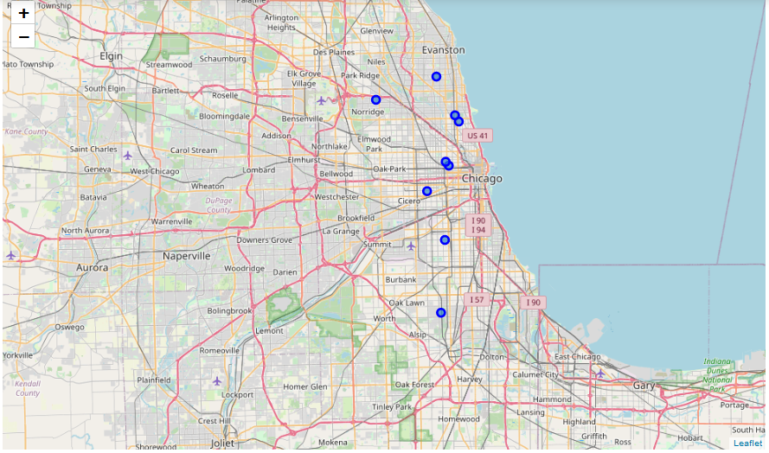
Results
Here the maps of all Elementary School at Chicago
Creation map of Chicago using latitude and longitude values
We can see the location of these School Elementary (their names…), the blue dots identify them

Slide 8
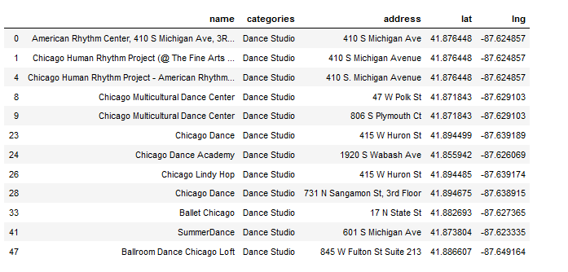
Results
This table shows us all the dance schools located in Chicago.
There are twelve dance schools in chicago.

Slide 9
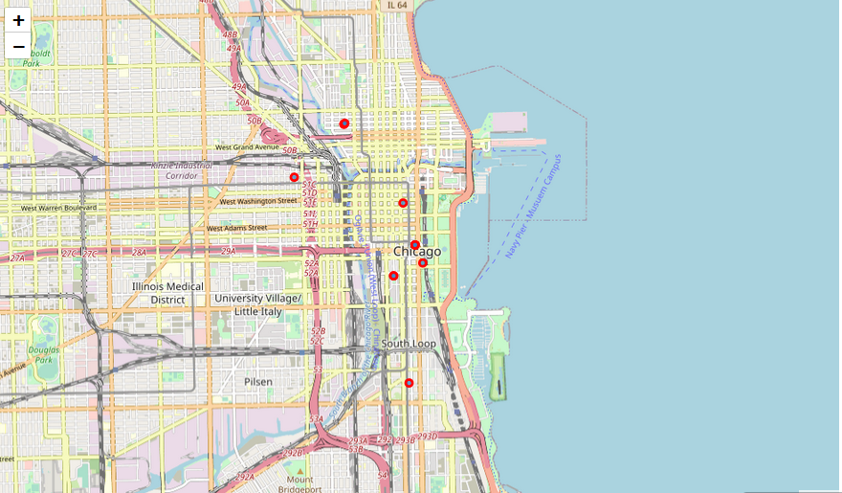
Results
Here the maps of all School Dance at Chicago
We can see the location of these School Dance (their names…), the red dots identify them

Slide 10
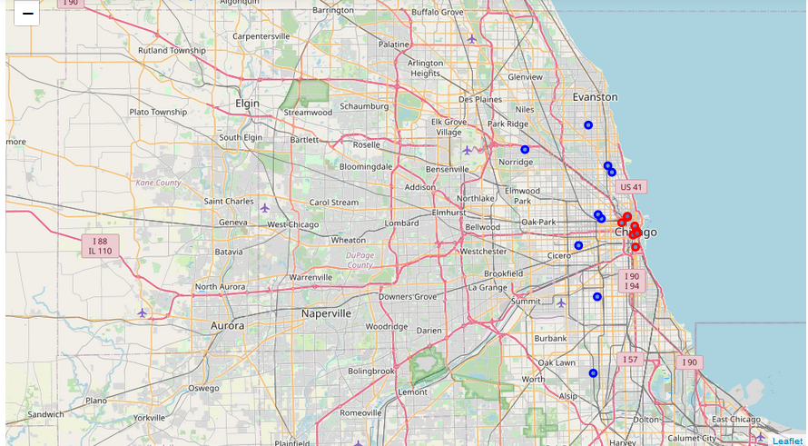
Results
This map shows us each point of each school either elementary school or dance school so this map shows us very well the elementary students who have a very high education and a very reliable security, Teachers Score and those closest to at least one dance school we have identified are the schools of Michell Elementary School and Chopin Elementary School.
The The red dots identify the School dance
The The blue dots identify the School Elementary

Slide 11
Conclusion
There are many elementary schools in Chicago about 566 elementary schools in various area communities, A GPS could guide you well or a map.
Our problem was to find a Dance School close to an Elementary School at Chicago and that the elementary school would be a good school by certain criteria such as:
SAFETY_SCORE
Instruction Score
Teachers Score
Enough security of very competent teachers and a very high level of instruction so that the children would be literally well.
After doing our analysis and research through Foursquare, Folium, Clustering and others, there are two Elementary schools with the required criteria that are located near a dance school in Chicago their names are:
Michell Elementary School
Chopin Elementary School.

Slide 12
Recommendation
Parents will be able to manage their time when they put their children in an elementary school with a high education score and find a Dance School close enough to that Elementary School and its Elementary School with high education score is good enough to take care of the students' education. Even if there are parents who will not put their children in a ready-made Dance School .

